Slide 1
Microsoft Flow best practices, warning, tips, tricks
Serge Luca, Isabelle Van Campenhoudt
Notes:
This slide is mandatory. Please do not remove.

Slide 2
Notes:
This slide is mandatory. Please do not remove and try to use it during Q&A at the end of your session. Thank you!

Slide 3

Serge Luca aka “Doctor Flow”
Managing Partner at ShareQL
About Serge
Professional Skills
12 x SharePoint MVP, Brussels
SharePoint since 2002
O365 Architect (Admin, Dev, governance)
Worked for the .Net MS Workflow Foundation team
Blog: http://sergeluca.wordpress.com/
sergeluca@shareql.com
@sergeluca
SharePoint
Flow
Dev
Architecture
Bullshit

Slide 4
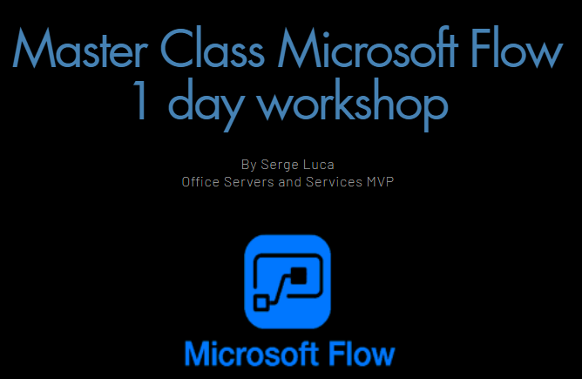
Go to www.ShareQL.com

Slide 5


Isabelle Van Campenhoudt
Managing Partner at ShareQL
About Isabelle
Professional Skills
6X Data Platform MVP, Brussels
Consultant, Speaker Trainer,
PASS Community Leader
SQL server since 1999
SharePoint BI & Power BI since it starts
Blog: theSQLGrrrl.wordpress.com
ivc@shareql.com
Twitter: @theSQLgrrrl
http://GUSS.pro
SQL
BI
Tuning
Architecture
Coffee making

Slide 6
Agenda
Agenda
Agenda
Agenda

Slide 7
Agenda
02
04
06
Environment +
Data Loss
prevention
Price &
roadmap
Creating Flows
01
03
05
Introduction
The concept
Flows and
on premises
Extensibility :
communication with
the outside world

Slide 8
Agenda
Agenda
The Concept
Agenda

Slide 9
4 main Benefits
Personal productivity
Collaboration
Citizen development
Bridge between Applications
Notes:
Quickly create (0 code) Business Processes apps

Slide 10
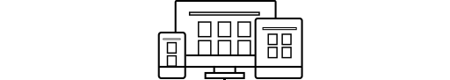





The context-Business Apps
Build modern business app fast
MEASURE
ACT
AUTOMATE
Empower power users
Power BI
PowerApps
Microsoft Flow
More efficient developers
SQL Server BI
Data analytics
Internet of Things (IoT)
…
App Services
Service Fabric
Azure Functions
…
Azure functions
Graph api
SharePoint REST api
…
Connect data across apps
Common Data Model
Connectors & Gateways

Slide 11
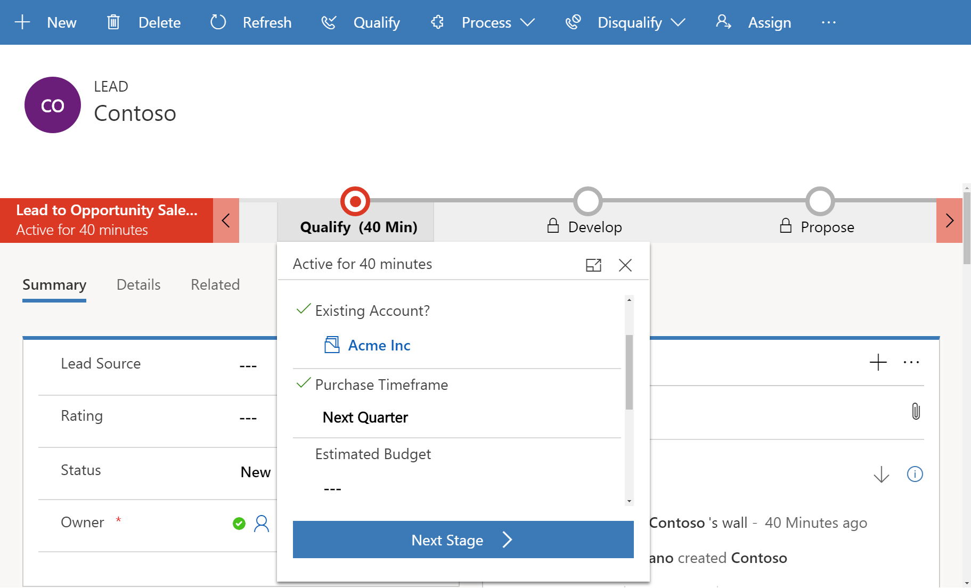
PowerApps & Flow = buildings blocks for Microsoft ERP & CRM Online (Dynamics 365)

Slide 12
Creating Flow
Agenda

Slide 13
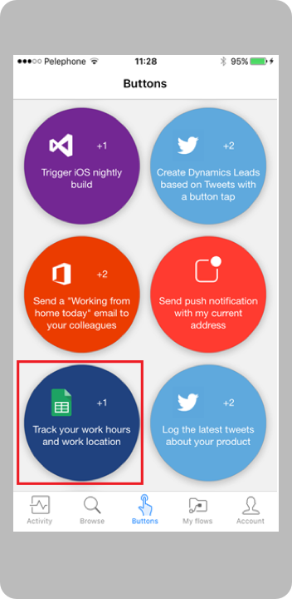
Creating and managing Flows
Microsoft Account (free) or Office 365 or Dynamics 365 or Flow (paid) or PowerApps (or free new PowerApps Community Plan)
Flow.microsoft.com
Powerapps.microsoft.com
A modern SharePoint Online list / document library
Mobile app (iOS-Android-Windows Mobile)

Slide 14
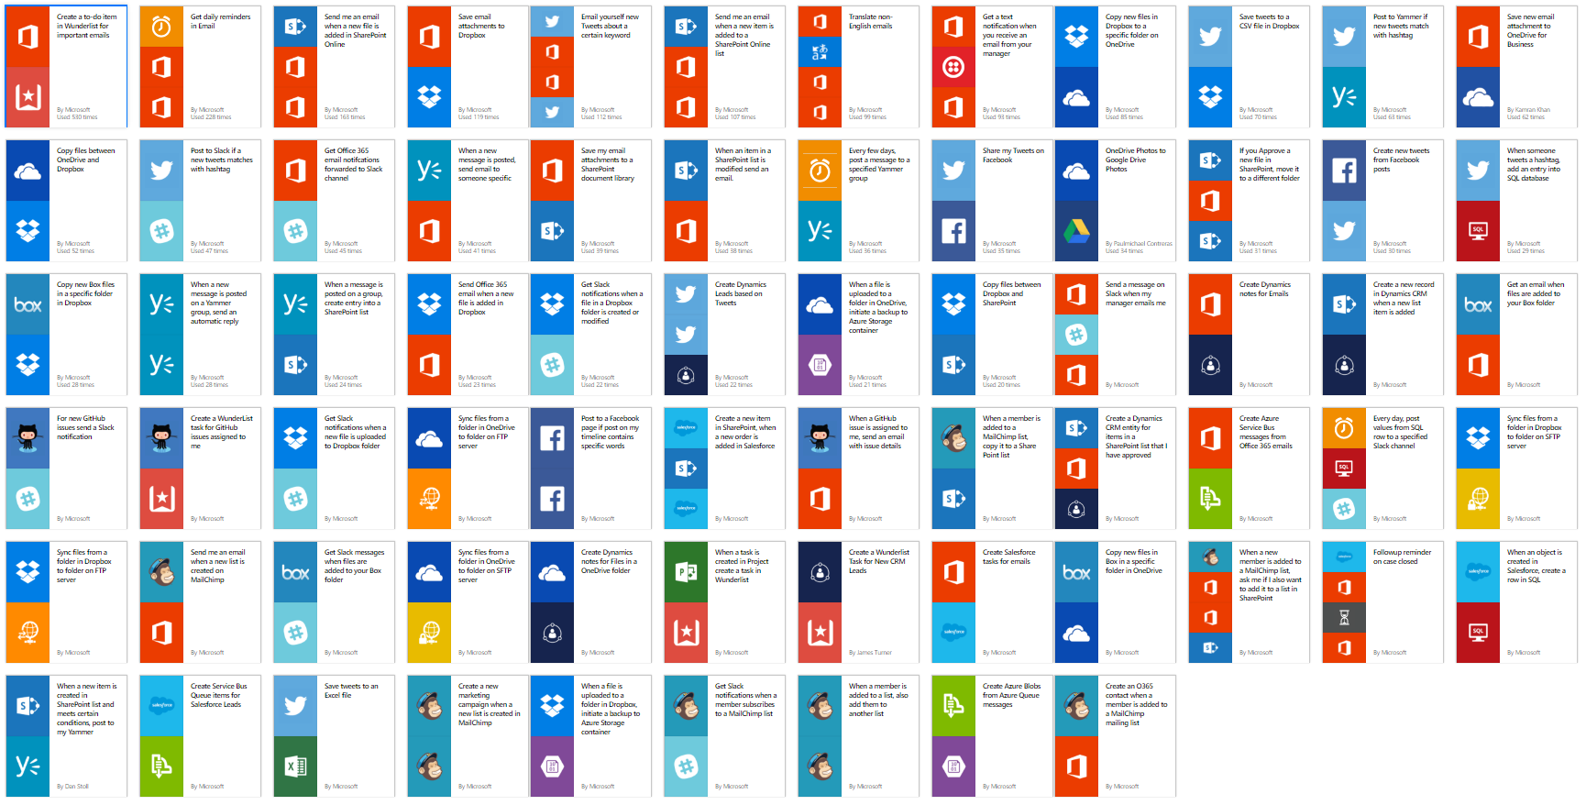
Flow templates

Slide 15
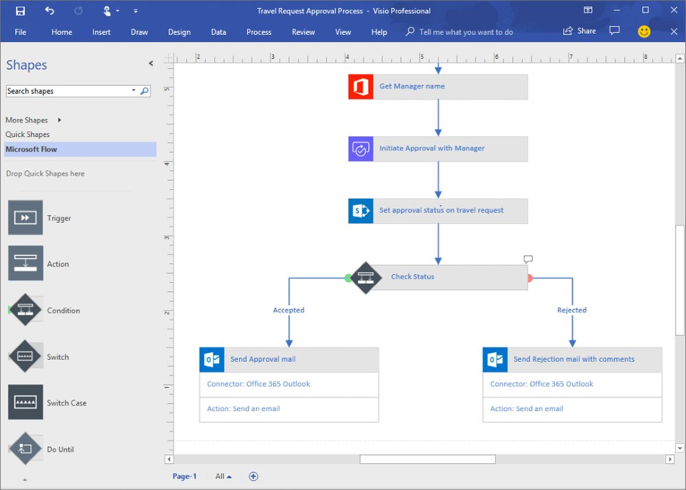

Slide 16
demo
Expense report
Notes:
Until here : 10 minutes
7 minutes for the demo = 17 minutes

Slide 17
Approval escalation in Flow
New incident
Manager
approval
No response in 3 days
Notify employee
Director
approval
No response in 2 days
Notify employee

Slide 18
Approval problems…
What do we do if the item (to be approved) is deleted ?
What if the flow is cancelled ?
approval reassignment
(cannot hide it, does not work with states)
Flow limitations :
flow duration = max 30 days
Approval duration =
max 30 days
->What if Approval 1 = 20 days & Approval 2 = 15 days ?

Slide 19
Limitations
250 actions/flow
Create nested flows
Loops
Max 5.000 iterations in Do until
Max 5.000 iterations in For each (100.000 in Plan 1)
SharePoint
No OOB site level actions ->roadmap ( new : Send An Http Request To SharePoint )
Cannot OOB change item security ->roadmap ( new : Send An Http Request To SharePoint )
SharePoint security model is not Flow security model (roadmap)
Notes:
250 flow/ environmt

Slide 20
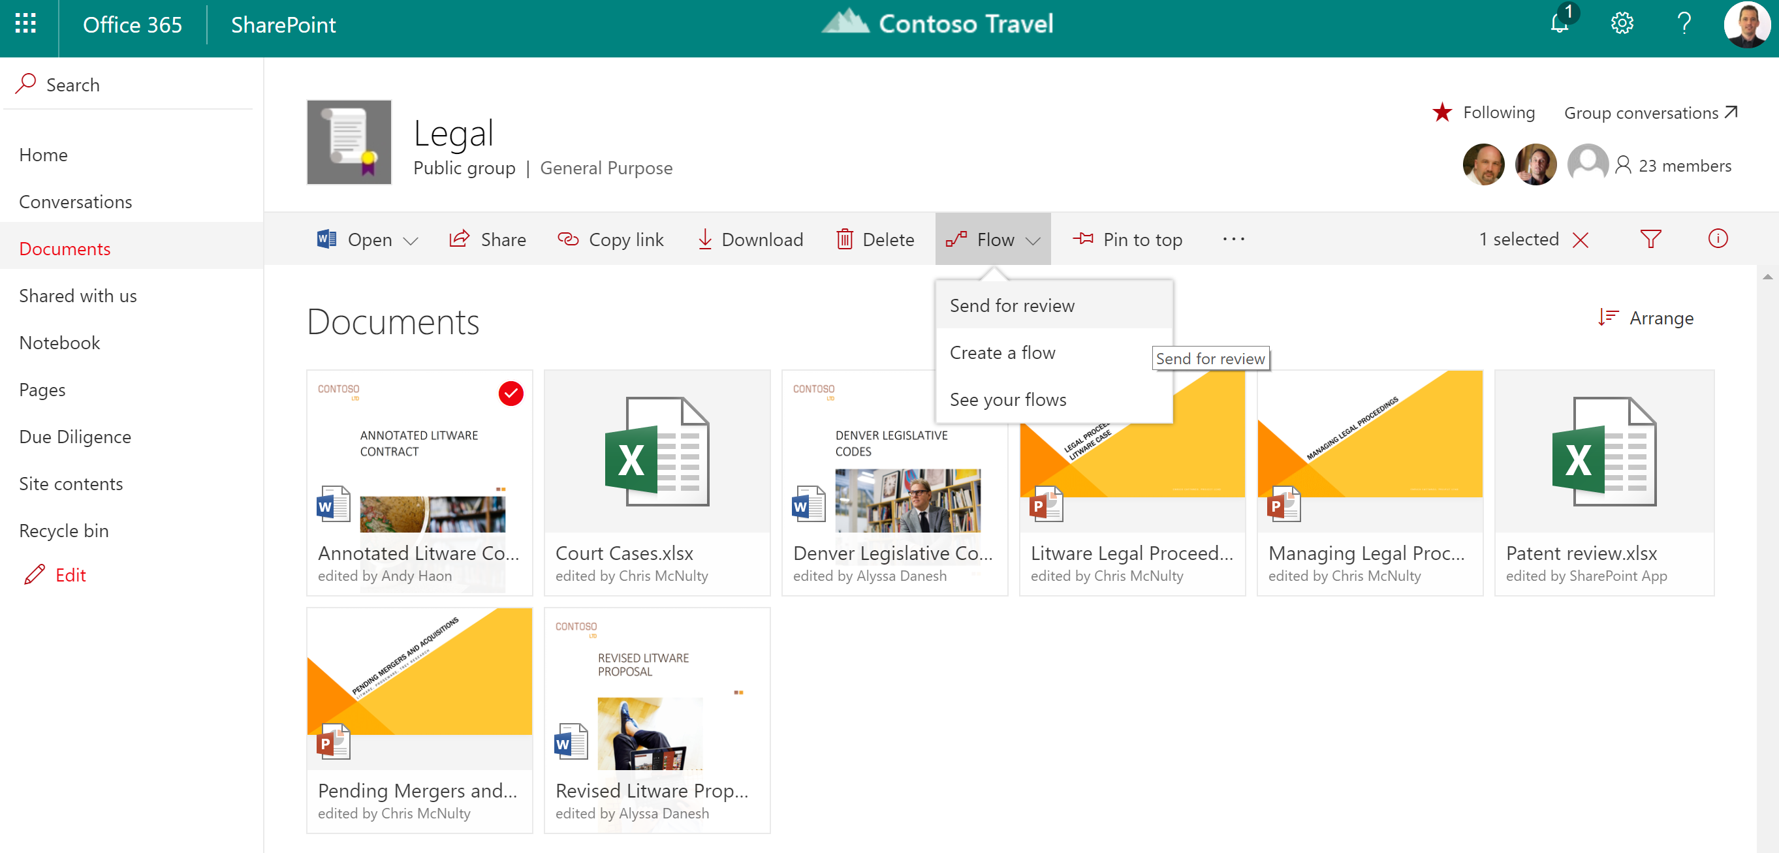
Limitations
No out of the box send for review
soon
Notes:
16’

Slide 21
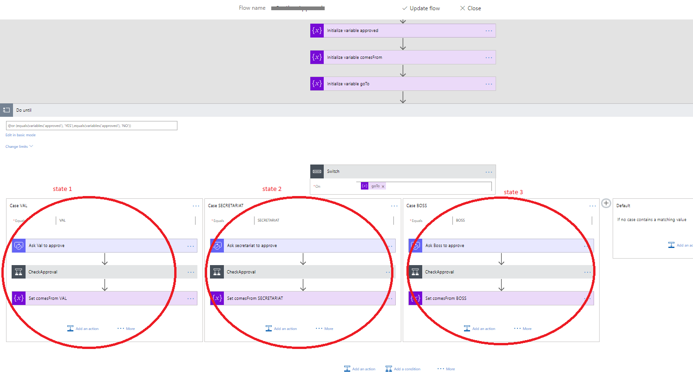
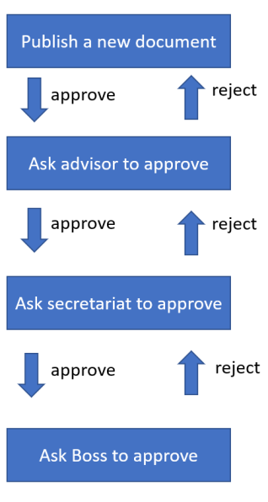
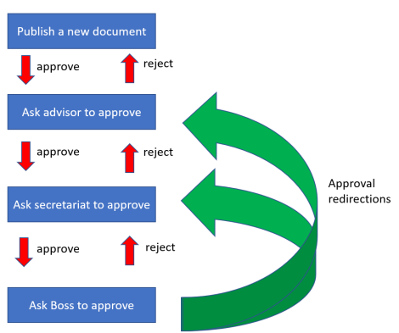
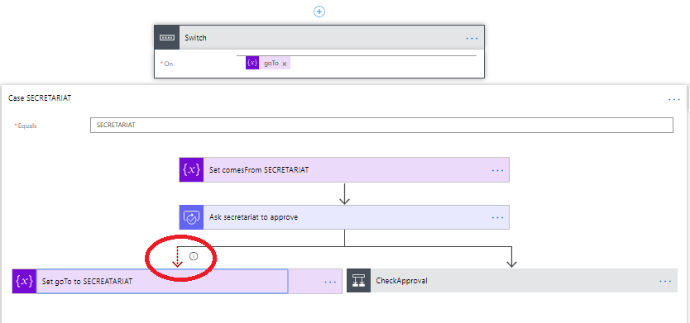
Limitation : no state machines

Slide 22

Limitation : no custom approval form

Slide 23
Microsoft Flow and On Premises
Agenda
Notes:
13’+hotdog

Slide 24
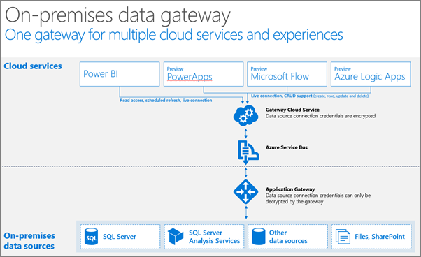
Flow and data on premises/hybrid
Install the « on Premises data gateway »
(shared between PowerBI, PowerApps and Azure Logic Apps)
Not just databases, but also Powershell scripts, files and even REST API web services
Notes:
https://docs.microsoft.com/en-us/power-bi/service-gateway-onprem-indepth

Slide 25

SharePoint 2019 and Microsoft Flow/PowerApps are becoming good friends !!!

Slide 26
demo
Flow & Data on preM
Notes:
Jusqu’ici: 7 min
Duréee 8-10 min Demo scan Ondrive
If doesn’t work set filepath is the content parameter (send mail)
https://shareql.sharepoint.com/demosharepoint/nintext/
Show how to login
App launcher ?
SharePoint list online
Show services https://flow.microsoft.com/en-us/services/ ( > 60 services)
Show templates
Type « SharePoint » to see sharepoint actions and « Office 365 »
Triggers ( show triggers)
Triggers in SharePoint
Show flow « ShareQL expense » When a new item is created in expenses, ask my manager approve it if it is > 500 euros

Slide 27
Environments

Slide 28
Environments & compliance
Isolated spaces where Flows/Data are running/stored
Ex HR, Marketing, Operations, Legal, DEV, TEST, UAT, PROD…
Different rules (DLP)
Ex « Marketing can use twitter, But Legal and Operations cannot »
Different regions if needed
[Plan 2 for creating & using several Env]

Slide 29
ENVIRONMENTS
DEV MARKETING
TEST MARKETING
UAT MARKETING
PROD MARKETING
DEV OPERATIONS US
DEV OPERATIONS EUROPE
TEST OPERATIONS US
TEST OPERATIONS EUROPE
US
UAT OPERATIONS US
EU
UAT OPERATIONS EUROPE
PROD OPERATIONS US
PROD OPERATIONS EUROPE
DLP
DLP

Slide 30
Attention
We can export-import Flows from Env1 to Env2
We have to recreate the connections (fixed in roadmap)
SharePoint lists based on GUID (! From SharePoint test site to SharePoint prod site !)
On premise data gateway :
Gateways only in the default environment

Slide 31
Extensibility &
Communication with the outside world

Slide 32
Call – Flow - Called
PowerApps calls Flow & return info to PowerApps
Action Request (usually coupled with Response action)
Action Http (generic)
Action Send an http Request to SharePoint
Custom Connector (REST API described in a Swagger/Open API )
A custom app calls Flow (« Flow as a service »)
Flow calls the outside world
PowerBI calls Flow (Data Alerts)

Slide 33
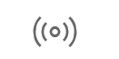
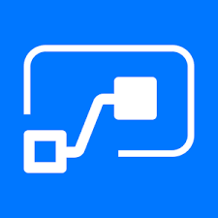



Power BI & Flow
LIVE
STREAMING DATA
FLOW
SCHEDULED REFRESH
POWER BI
DATA SOURCES
DATA ALERTS

Slide 34
Pricing & roadmap

Slide 35


Tarifs: Comparaison

Slide 37
Advices
Keep your forms as simple as possible
Manage the business logic in the workflows
Use environments
Accounts :
For Enterprise workflows define system accounts for your connections
For personal workflows use personal accounts
Limitations
Create state machines if several levels of approval
Manage errors (see pattern)
Manage very long calls (see pattern )
Powershell Cmdlets to help for Management & GDPR
Notes:
Error handling pattern: https://sergeluca.wordpress.com/2018/03/12/pattern-for-microsoft-flow-error-handling/
Long calls : https://sergeluca.wordpress.com/2018/02/04/pattern-implementation-for-making-long-async-http-calls-in-microsoft-flow-part-2-http-webhook/

Slide 38
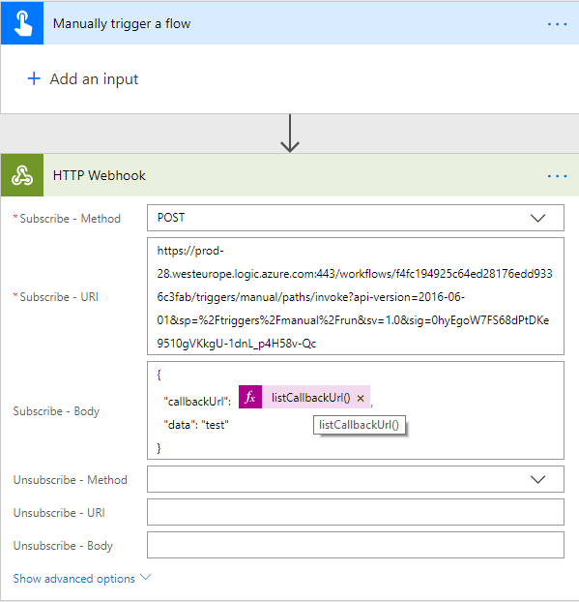
Calling a long Service (callback)

Slide 39
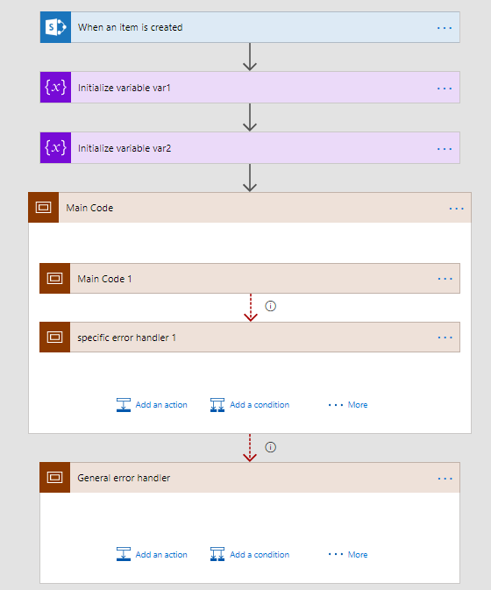
Error Handling
Notes:
https://sergeluca.wordpress.com/2018/03/12/pattern-for-microsoft-flow-error-handling/

Slide 40
Conclusions

Slide 41
Room for improvement
Workflow engine very reliable, but test the connectors
No state machines (but we have loops and switch)
Approval forms cannot be customized
JSON knowledge could be required (but less and less…)
Flow duration : 30 days, Approval : 30 days
Weak for long business processes !
Expressions : powerful, but steep learning curve

Slide 42
Positive
Easy tool
Not just SharePoint (it replaces SPD)
Connections to hundreds of services
Including on prem!
SharePoint Integration is getting better
PowerApps, PowerBI integration
The Team Flow is very proactive & delivers

Slide 43


@sergeluca
@theSQLgrrrl
https://sergeluca.wordpress.com/

Slide 45
Demo title

